Slide 2
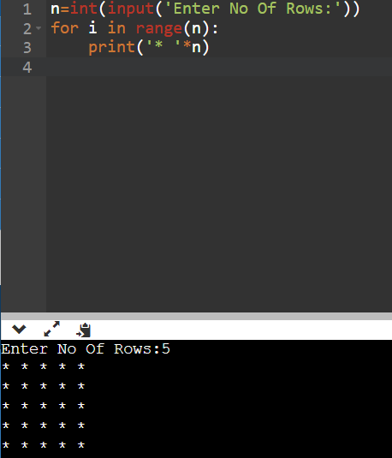
To print square pattern with * symbols

Slide 3
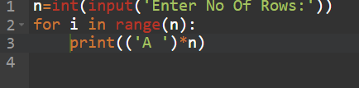
To print square pattern with fixed alphabet symbol

Slide 4
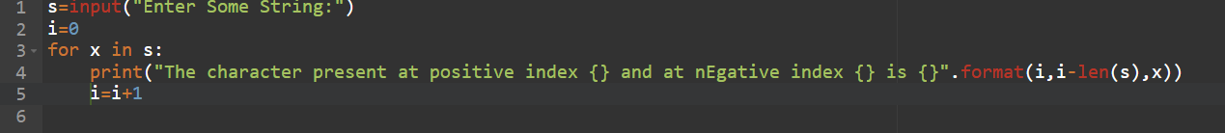
Write a program to accept some string from the keyboard and display its characters by index wise(both positive and negative index)

Slide 5
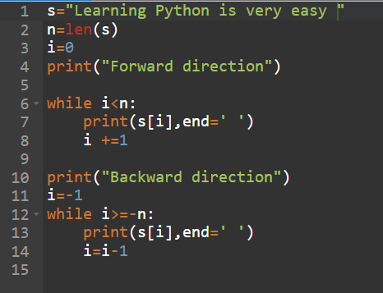
Write a program to access each character of string in forward and backward direction by using while loop?

Slide 6
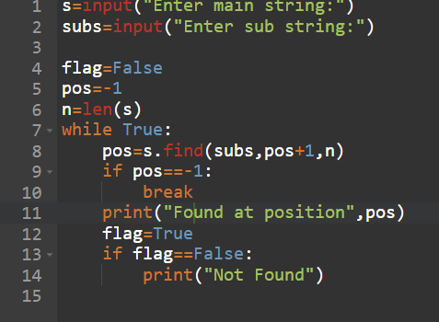
Program to display all positions of substring in a given main string

Slide 7
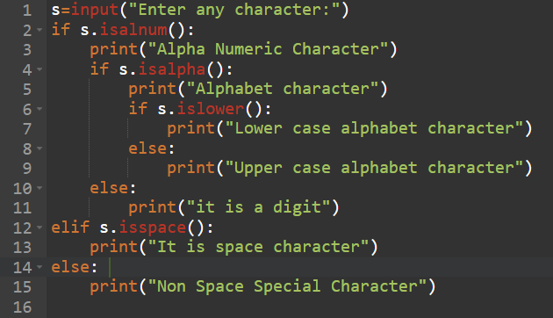
Write a program to take input of a single character and check if it is
"Alpha Numeric Character"
"Alphabet character"
"Lower case alphabet character"
"Upper case alphabet character"
"It is a digit"
"It is space character"

Slide 8
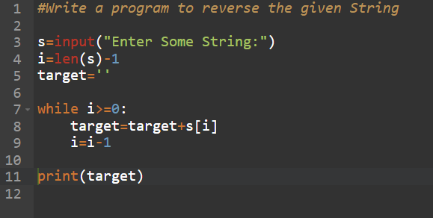

Slide 9
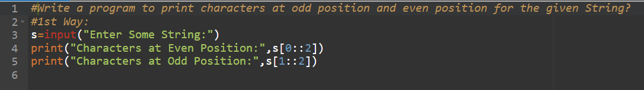
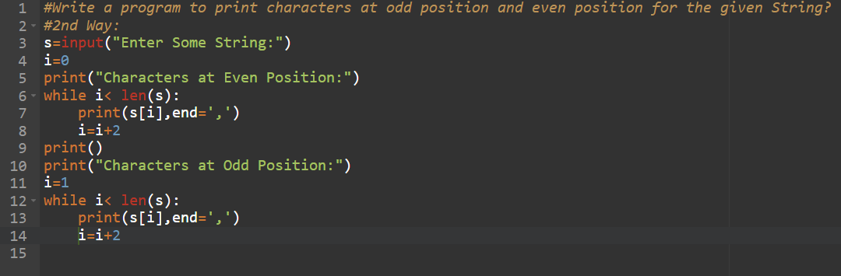

Slide 10
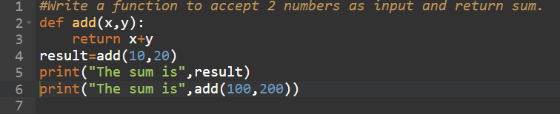

Slide 11
